Slide 1
3 The Pigeonhole Principle
Zhou Xiaoyu zhouxy@seu.edu.cn
room 427, Building of School of Computer Science & Engineering

Slide 2
3.1 Pigeonhole Principle: Simple Form

Slide 3
Theorem 3.1.1.
If n + 1 objects are distributed into n boxes, then at least one box contains two or more of the objects.
Proof (by contradiction).
If each of the n boxes contains at most one of the objects, then the total number of objects is at most 1 + 1 + ... + 1(n 1s) = n. Since we distribute n + 1 objects, some box contains at least two of the objects.

Slide 4
Pigeonhole Principle
An approach to demonstrate existence.
Application of pigeonhole principle.
It is necessary to identify the objects and the boxes, and there numbers.
Informal understanding: the number of boxes is not enough to keep the objects out of conflict.

Slide 5
Another Kind of Expression
If n + 1 objects are colored with n colors, then two objects have the same color.

Slide 6
Functional View
f: A -> B, |A| = n+1, |B| = n

Slide 7
Example
Application 1. Among 13 people there are 2 who have their birthdays in the same month.
Application 2. There are n married couples. How many of the 2n people must be selected to guarantee that a married couple has been selected?

Slide 8
Other Principles Related to the Pigeonhole Principle (for self study)
If n objects are put into n boxes and no box is empty, then each box contains exactly one object.
If n objects are put into n boxes and no box gets more than one object, then each box has an object in it.
Proof by contradiction (reduction to absurdity).

Slide 9
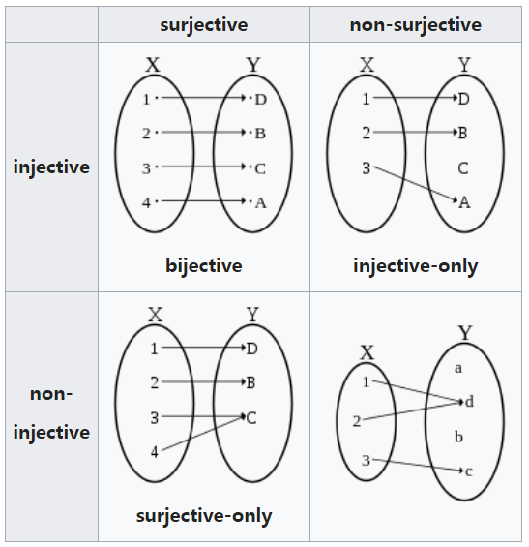
Functional View(for self study)
Let X and Y be finite sets and let f : X -> Y be a function from X to Y.
If X has more elements than Y, then f is not one-to-one(injective).
If X and Y have the same number of elements and f is onto(surjective), then f is one-to-one correspondence(bijection).
If X and Y have the same number of elements and f is one-to-one, then f is onto.

Slide 10
One-to-one Function cf. One-to-one Correspondence (for self study)
The term one-to-one function (a. k. a. injective function)must not be confused with one-to-one correspondence (a.k.a. bijective function), which uniquely maps all elements in both domain and codomain to each other.

Slide 11
Application 3
Given m integers a₁, a₂, ... ,a_{m}, there exist integers k and l with 0 =< k < l <=m such that a_{k+1} + a_{k+2} + ... + a_{l} (denoted by Σ _{(k+1)l}) is divisible by m. Less formally, there exist consecutive a's in the sequence a₁, a₂, ... ,a_{m} whose sum is divisible by m.
Train of thought
List all possible solutions
Top right side of the table (including the grid on the diagonal
line)
Are they independent with each other?
Σ_{ij} = Σ_{1j} - Σ_{1(i-1)}, where Σ₁₀ = 0.
 | 1 | 2 | 3 | … | m
1 | Σ₁₁ | Σ₁₂ | Σ₁₃ |  | Σ_{1m}
2 |  | Σ₂₂ | Σ₂₃ |  | Σ_{2m}
3 |  |  | Σ₃₃ |  | Σ_{3m}
…
m |  |  |  |  | Σ_{mm}

Slide 12
Application 3 (Train of Thought)
Representation of “divided by m”
Denote Σ_{1j} as Σ_{j}
Σ_{ij} = nm，
Σ_{j} - Σ_{(i – 1)} = nm
Σ_{j} = n_{j}m + k, 0 <= k <= m-1
Σ_{(i -1)} = n_{(i -1)}m + k, 0 <= k <= m-1
if k = 0: …
if k <> 0: 1 <= k <= m-1
m sums with m – 1 remainders
Among arbitrary m integers, at least 2 of them have the same remainder divided by m.

Slide 13
Application 4
A chess master who has 11 weeks to prepare for a tournament decides to play at least one game every day but, to avoid tiring himself, he decides not to play more than 12 games during any calendar week. Show that there exists a succession of (consecutive) days during which the chess master will have played exactly 21 games.
Exist Σ_{ij} = 21?
1 <= Σ_{ij} <= 11 * 12 = 132, for 3003 Σ_{ij}s: useless.
1 <= Σ_{j} <= 11 * 12 = 132, for 77 Σ_{j}s, seems useless either.

Slide 14
Application 4: train of thought
How to understand “play at least one game every day but, to avoid tiring himself, and not to play more than 12 games during any calendar week. ”
Σ_{j} ∈ [1, 12] within a week, not full, not very sparse
How to express such kind of a “number sense”(小平邦彦《惰者集》)
Σ_{j}s are increasing monotonically, can differences between Σ_{j}s be arbitrarily large?
Obviously not, is there a minimum difference value?
Assumption: exist 1 <= i, j <= 7, Σ_{j} - Σ_{i} = 1, proof by deducing the possible value of Σ_{i} in the incremental order of i,

Slide 15
Application 4: train of thought
Dense: exist 1 <= i, j <= 7, Σ_{j} = Σ_{i} + 1: informally, the Σ_{i}S cannot avoid to equal to values of (Σ_{i} + 1)s
1 <=Σ_{1,} Σ_{2,} Σ_{3, …,} Σ₇ <= 12
2 <= Σ₁ + 1, Σ₂ + 1, Σ₃ + 1, … , Σ₇ + 1 <= 13
1 <= Σ_{1,} Σ_{2,} Σ_{3, …,} Σ_{7,} Σ₁ + 1, Σ₂ + 1, Σ₃ + 1, … , Σ₇ + 1 <= 13
13 values for 14 numbers
Σ_{1,} Σ_{2,} Σ_{3, …,} Σ₇ are strictly monotonic incremental
So is Σ₁ +1, Σ₂ + 1, Σ₃ + 1, … , Σ₇+ 1
Is there any Σ_{j} = Σ₇ + 1 or Σ₁ = Σ_{i} + 1? Impossible
2 <= Σ_{2,} Σ_{3, …,} Σ_{7,} Σ₁ + 1, Σ₁ + 1, Σ₁ + 1, … , Σ₆ + 2 <= 12
11 values for 12 numbers, does not change the result.

Slide 16
Application 4: train of thought
Informal understanding contributes to more open thinking.
Pigeon hole principle provide a sufficient condition, not necessary condition.
For the previous example,
1 <= Σ_{1,} Σ_{2,} Σ_{3, …,} Σ_{7,} Σ₁ + 2, Σ₂ + 2, Σ₃ + 2, … , Σ₇ + 2 <= 14
14 values for 14 numbers
We can not draw a conclusion that there should exist Σ_{j} - Σ_{i} = 2
But if we enumerate the possible values of Σ_{j}, we can found that the conclusion is true. Otherwise, the minimal list is 1, 2, 5, 6, 9, 10, 13

Slide 17
Application 4
Replace Σ_{i} with a_{i}
1<= a₁ < a₂ < … <a₇₇<=12*11=132
22<=a₁ + 21 < a₂ + 21 < … <a₇₇ + 21 <=132 +21 = 153
Thus each of the 154 numbers
a₁, a₂ , … , a₇₇, a₁ + 21, a₂ + 21, …, a₇₇ + 21
is an integer between 1 and 153.
We can get the conclusion that for each 1 <= d <= 21, there is a_{j} – a_{i} = d.

Slide 18
Application 5_{(for self study)}
From the integers 1,2, ... ,200, we choose 101 integers. Show that, among the integers chosen, there are two such that one of them is divisible by the other.

Slide 19
Application 5 (Train of Thought) (for self study)
How to express ”one is devisable by the other”
b, bk
More
b, bk, b(k + 1), b(k + 2), … ?
b, bk, b²k, b³k, … ,
How to choose b and k
For b: 1, 2, or 200, or some other number?
As small as possible: 1? 2?
For k: Thinking inductivly. Express the numbers between 1 and 200 using 2^{i} * k: 2⁰*1, 2¹*1, 2⁰*3, 2²*1, 2⁰*5, …
2^{i} * k: k is odd

Slide 20
Application 5_{(for self study)}
There is no such a k that makes the intersection of a series of 2^{i} x k and an arbitrary 101-subset has more than two words.
But it makes a partition of the integers from 1 to 200. Each pair of integers in the same equivalent class has a relation of divisibility.
any integer can be written in the form 2^{i} * k, where i >= 0 and k is odd. For an integer between 1 and 200, k is one of the 100 numbers 1, 3, 5, ... ,199. Thus among the 101 integers chosen, there are 2^{i} * k and 2^{j} * k.

Slide 21
Application 6. (Chinese Remainder Theorem)
Let m and n be relatively prime positive integers, and let a and b be integers where 0 <= a <= m - 1 and 0 <= b <= n - 1. Then there is a positive integer x such that x = pm + a and x = qn + b for some integers p and q.

Slide 22
Application 6
It is only necessary to consider p and q such that
0 <= p < n, 0 <= q < m.
Else: x := x - kmn
we list all the n possible candidates:
a, m + a, 2m + a, ... , (n - 1)m + a.
Express the equivalent relation mentioned in the question:
im + a = q_{i}n + r_{i} there are n r_{i} s
There should be an i such that r_{i} = b for b with any value.
Speculation: for all 0 <= r <= n – 1, there is an i that makes r_{i} = r.

Slide 23
Application 6
Otherwise, two of them had the same remainder r when divided by n.
Then there are integers q_{i} and q_{j} such that im + a = q_{i}n + r and jm + a = q_{j}n + r.
we get (j - i)m = (q_{j} - q_{i})n.
It means that n is a factor of the number (j - i)m: Contradiction

Slide 24
3.2 Pigeonhole Principle: Strong Form

Slide 25
Theorem 3.2.1
Let q₁, q₂,... , q_{n} be positive integers. If q₁+q₂+...+q_{n}-n+1 objects are distributed into n boxes, then either the first box contains at least q₁ objects, or the second box contains at least q₂ objects, ... , or the nth box contains at least q_{n} objects.
Proof:
(q₁ – 1) + (q₂ -1)+ ... + (q_{n} -1) = q₁ + q₂ + ... + q_{n} - n

Slide 26
Relation with the Simple Form
The simple form of the pigeonhole principle is obtained from the strong form by taking q₁ = q₂ = ... = q_{n} = 2. Then q₁ + q₂ + ... + q_{n} - n + 1 = 2n - n + 1 = n + 1.

Slide 27
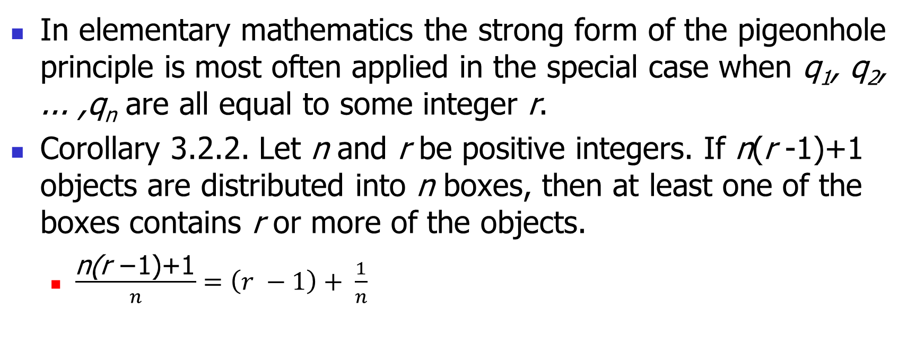
Corollary 3.2.2
In elementary mathematics the strong form of the pigeonhole principle is most often applied in the special case when q₁, q₂, ... ,q_{n} are all equal to some integer r.
Corollary 3.2.2. Let n and r be positive integers. If n(r -1)+1 objects are distributed into n boxes, then at least one of the boxes contains r or more of the objects.
$\frac{\text{n}\text{(}\text{r} \text{−1)+1}}{n}=\left(r −1\right)+ \frac{1}{n}$

Slide 28
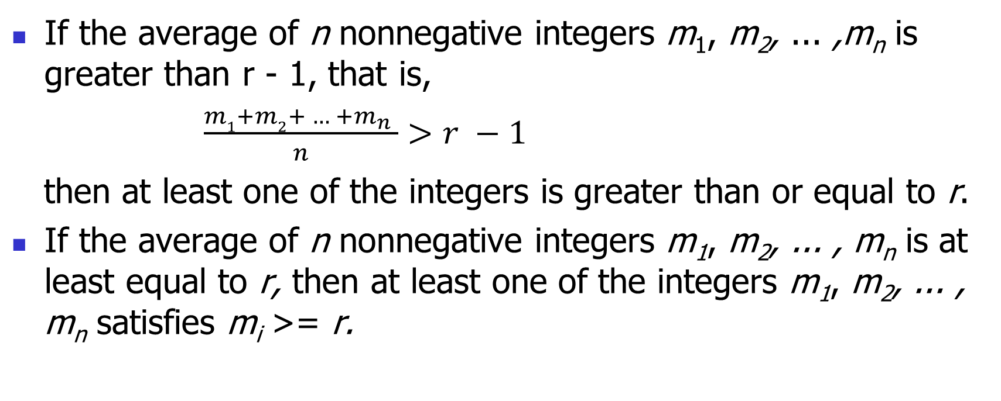
Averaging Principle
If the average of n nonnegative integers m₁, m₂, ... ,m_{n} is greater than r - 1, that is,
$\frac{m1+m2+ … +m_{n} }{n}>r −1$
then at least one of the integers is greater than or equal to r.
If the average of n nonnegative integers m₁, m₂, ... , m_{n} is at least equal to r, then at least one of the integers m₁, m₂, ... , m_{n} satisfies m_{i} >= r.

Slide 29

A Different Averaging Principle
If the average of n nonnegative integers m₁, m₂, ... , m_{n} is less than r + 1, that is, $\frac{m_{1}+m_{2}+ … +m_{n} }{n}<r+1$
then at least one of the integers is less than r + 1.

Slide 30
Application 7
A basket of fruit is being arranged out of apples, bananas, and oranges. What is the smallest number of pieces of fruit that should be put in the basket to guarantee that either there are at least eight apples or at least six bananas or at least nine oranges?
Solution
(8 – 1) + (6 – 1) + (9 – 1) + 1 = 21

Slide 31
Application 8
Two disks, one smaller than the other, are each divided into 200 congruent sectors. In the larger disk, 100 of the sectors are chosen arbitrarily and painted red; the other 100 sectors are painted blue. In the smaller disk, each sector is painted either red or blue with no stipulation on the number of red and blue sectors. The small disk is then placed on the larger disk so that their centers coincide. Show that it is possible to align the two disks so that the number of sectors of the small disk whose color matches the corresponding sector of the large disk is at least 100.

Slide 32
Application 8 (Train of Thought)
Number of matching sectors
How many numbers, the sum of the numbers？
The process of checking all matching sectors?
Turn the small disk, moving one sector every time.
199 moves, 200 positions: 100 matches per sector
The sum of matching sectors for all 200 positions?
What contributes to the sum?
Let m_{i, j} denotes whether sector i matches at position 200.
m_{1,1} + m_{1,2} + … + m_{1, 200} = 100
m_{2,1} + m_{2,2} + … + m_{2, 200} = 100
…
m_{200,1} + m_{200,2} + … + m_{200, 200} = 100
Σ = 100*200 matches for 200 positions

Slide 33
Application 8 (Solution)
Fix the large disk, and turn the small disk around, moving one sector every time.
each sector of the small disk will match in color the corresponding sector of the large disk in exactly 100 possible positions.
the total number of color matches over all the positions: 100 *200
the average number of color matches per position is 20,000/200=100

Slide 34
Application 8 (Train of Thought)
Refining and tracking the whole process.
If you have no idea of the overall situation, you can study the individual component one by one.
It’s kind of like a detective solving a criminal case.

Slide 35

Application 9
Show that every sequence $a_{1}$, $a_{2}$, ... ,$a_{n^{2}+1}$ of n² + 1 real numbers contains either an increasing subsequence of length n + 1 or a decreasing subsequence of length n + 1.
(a_{i}, …, a_{j}, …), a_{i} < a_{j}, where i < j,

Slide 36
Application 9
We suppose that there is no increasing subsequence of length n + 1 and show that there must be a decreasing subsequence of length n + 1.
For each k = 1, 2, ... , n²+1, let m_{k} be the length of the longest increasing subsequence that begins with a_{k}.
m_{k} <= n for each k.

Slide 37
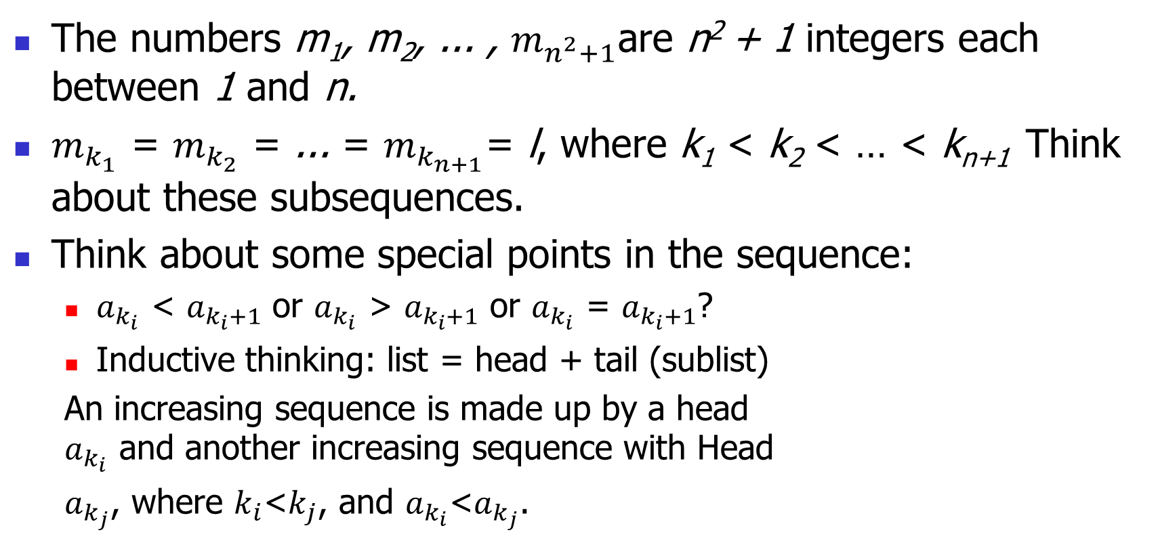
Application 9
The numbers m₁, m₂, ... , $m_{n^{2}+1}$are n² + 1 integers each between 1 and n.
$m_{k_{1}}$ = $m_{k_{2}}$ = ... = $m_{k_{n+1}}$= l, where k₁ < k₂ < … < k_{n+1} Think about these subsequences.
Think about some special points in the sequence:
$a_{k_{i}}$ < $a_{k_{i}+1}$ or $a_{k_{i}}$ > $a_{k_{i}+1}$ or $a_{k_{i}}$ = $a_{k_{i}+1}$?
Inductive thinking: list = head + tail (sublist)
An increasing sequence is made up by a head $a_{k_{i}}$ and another increasing sequence with Head
$a_{k_{j}}$, where $k_{i}$<$k_{j}$, and $a_{k_{i}}$<$a_{k_{j}}$.

Slide 38
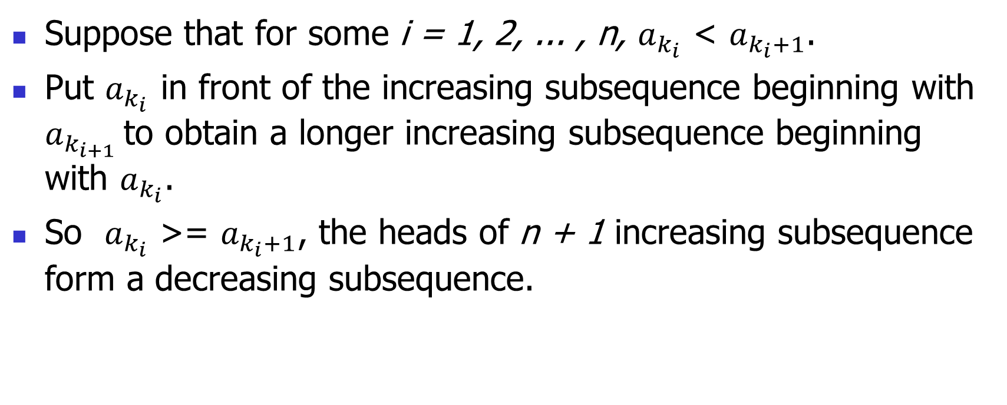
Application 9
Suppose that for some i = 1, 2, ... , n, $a_{k_{i}}$ < $a_{k_{i}+1}$.
Put $a_{k_{i}}$ in front of the increasing subsequence beginning with $a_{k_{i+1}}$ to obtain a longer increasing subsequence beginning with $a_{k_{i}}$.
So $a_{k_{i}}$ >= $a_{k_{i}+1}$, the heads of n + 1 increasing subsequence form a decreasing subsequence.

Slide 39
3.3 Ramsey’s Theorem

Slide 40
An Instance
the most popular and easily understood instance of Ramsey's theorem
Of six (or more) people, either there are three, each pair of whom are acquainted, or there are three, each pair of whom are unacquainted.
K₆ -> K₃, K_{3,} we mean by K_{n} a set of n objects and all of the pairs of these objects, i. e. a complete graph of n vertex.

Slide 41
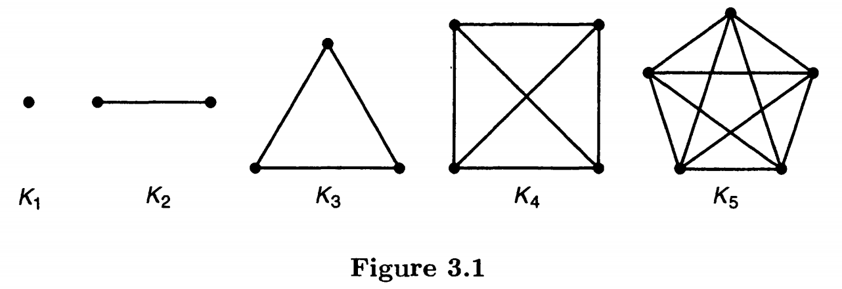
An Instance

Slide 42
An Instance
‘K₆ -> K₃, K₃‘ is the assertion that no matter how the edges of K₆ are colored with the colors red and blue, there is always a red K₃ or a blue K₃.
Suppose the edges of K₆ have been colored red or blue in any way.
Consider one of the points p of K₆. It meets five edges.
Since each of these five edges is colored red or blue, it follows that either at least three of them are colored red or at least three of them are colored blue.

Slide 43
An Instance
Without lose of generality, we suppose that three of the five edges meeting the point p are red.
Let the three red edges meeting p join p to points a, b, and c, respectively.
Consider the edges which join a, b, c in pairs.
If all of these are blue, then a, b, c determine a blue K₃.
If one of them, say the one joining a and b, is red, then p, a, b determine a red K₃ .
Thus, we are guaranteed either a red K₃ or a blue K₃.

Slide 44
Ramsey’s Theorem
Theorem 3.3.1. If m >= 2 and n >= 2 are integers, then there is a positive integer p such that
K_{p} -> K_{m}, K_{n}
If K_{p} -> K_{m}, K_{n}, then K_{q} -> K_{m}, K_{n} for every integer q >= p.
The Ramsey number r(m, n) is the smallest integer p such that K_{p} -> K_{m}, K_{n}.
r(m, n) = r(n, m).

Slide 45
r(2, n)
Conduct case study inductively：
r(2, 2), r(2, 3), …, r(2, n) => r(2, n) = n
proof
r(2, n) <= n: If we color the edges of K_{n} either red or blue, then either some edge is colored red (and so we have a red K₂) or all edges are blue (and so we have a blue K_{n}).
r(2, n) > n - 1: If we color all the edges of K_{n - 1} blue, then we have neither a red K₂ nor a blue K_{n}.

Slide 46
Proof of Ramsey’s Theorem
(double) induction on both integer parameters m >= 2 and n >= 2.
If m = 2, we know that r(2, n) = n, and if n = 2, we know that r(m, 2) = m.
We now assume that m >= 3 and n >= 3, and take as our inductive assumption that both r(m-1, n) and r(m, n-1) exist.

Slide 47
Proof of Ramsey’s Theorem
Let p = r(m - 1, n) + r(m, n -1). We will show that K_{p} -> K_{m}, K_{n} for this integer p.
Suppose that the edges of K_{p} have been colored red or blue in any way.
Consider one of the points x of K_{p}.
R_{x}: the set of points that are joined to x by a red edge,
B_{x:} the set of points that are joined to x by a blue edge.

Slide 48
Proof of Ramsey’s Theorem
|R_{x} | + | B_{x} | = p - 1 = r(m - 1, n) + r(m, n - 1) – 1.
Implies:
(1) |R_{x} | >= r(m - 1, n), or
(2) | B_{x} | >= r(m, n - 1).
Suppose that (1) holds. Let q = |R_{x} | so that q >= r(m - 1, n).
Then considering K_{q} on the points of R_{x}, we see that either
there are m - 1 points of K_{q} all of whose edges are colored red (that is, a red K_{m - 1}).
K_{m – 1} + R_{x} => red K_{m}
or there are n points all of whose edges are colored blue (that is, a blue K_{n}).
Similarly when (2) holds

Slide 49
Interpretation of K₆ -> K₃, K₃ as a case of Ramsey’s Theorem (for self study)
r(3, 3) = r(3-1, 3) + r(3, 3-1) = 3 + 3 = 6
Suppose the edges of K₆ have been colored red or blue in any way.
Consider one of the points p of K₆. It meets five edges.
Since each of these five edges is colored red or blue, it follows that either at least three of them are colored red or at least three of them are colored blue.
|R_{p} | + | B_{p} | = r(3, 3) - 1 = r(3 - 1, 3) + r(3, 3 - 1) – 1.
|R_{p} | >= r(3 - 1, 3) or | B_{p} | >= r(3, 3 - 1)

Slide 50
Interpretation of K₆ -> K₃, K₃ as a case of Ramsey’s Theorem (for self study)
Without lose of generality, we suppose that three of the five edges meeting the point p are red.
|R_{p} | >= r(3 - 1, 3)
Let the three red edges meeting p join p to points a, b, and c, respectively.
Points a, b and c form an K₃ where 3 = r(3 - 1, 3).
Consider the edges which join a, b, c in pairs.
If all of these are blue, then a, b, c determine a blue K₃.
If one of them, say the one joining a and b, is red, then p, a, b determine a red K₃ .

Slide 51
What We Can Learn From the Ramsey Theorem
Application of the strong form of pigeon hole principle in graph theory.
Induction on more than one variable.

Slide 52
Exercises
Simple form: 1, 3, 6, 9(题目改为：… two groups of people (with at least one person not shared by the two group)…),
Strong form: 14,
Ramsey theorem: 20

